Slide 1
Chapter 11 Relational Database Design Algorithms and Further Dependencies

Slide 2
Chapter Outline
Designing a Set of Relations
Properties of Relational Decompositions
Algorithms for Relational Database Schema
Multivalued Dependencies and Fourth Normal Form
Join Dependencies and Fifth Normal Form
Inclusion Dependencies
Other Dependencies and Normal Forms

Slide 3
DESIGNING A SET OF RELATIONS (1)
The Approach of Relational Synthesis (Bottom-up Design) :
Assumes that all possible functional dependencies are known.
First constructs a minimal set of FDs
Then applies algorithms that construct a target set of 3NF or BCNF relations.
Additional criteria may be needed to ensure the set of relations in a relational database are satisfactory (see Algorithms 11.2 and 11.4).

Slide 4
DESIGNING A SET OF RELATIONS (2)
Goals:
Lossless join property (a must) – algorithm 11.1 tests for general losslessness.
Dependency preservation property – algorithms 11.3 decomposes a relation into BCNF components by sacrificing the dependency preservation.
Additional normal forms
4NF (based on multi-valued dependencies)
5NF (based on join dependencies)

Slide 5
1. Properties of Relational Decompositions (1)
Relation Decomposition and Insufficiency of Normal Forms:
Universal Relation Schema: a relation schema R={A₁, A_{2,} …, A_{n}} that includes all the attributes of the database.
Universal relation assumption: every attribute name is unique.
Decomposition: The process of decomposing the universal relation schema R into a set of relation schemas D = {R₁,R₂, …, R_{m}} that will become the relational database schema by using the functional dependencies.

Slide 6
Properties of Relational Decompositions (2)
Relation Decomposition and Insufficiency of Normal Forms (cont.):
Attribute preservation condition: Each attribute in R will appear in at least one relation schema R_{i} in the decomposition so that no attributes are “lost”.
Another goal of decomposition is to have each individual relation R_{i} in the decomposition D be in BCNF or 3NF.
Additional properties of decomposition are needed to prevent from generating spurious tuples

Slide 7
Properties of Relational Decompositions (3)
Dependency Preservation Property of a Decomposition :
Definition:
Given a set of dependencies F on R, the projection of F on Ri, denoted by pRi(F) where Ri is a subset of R, is the set of dependencies X  Y in F+ such that the attributes in X υ Y are all contained in Ri. Hence, the projection of F on each relation schema Ri in the decomposition D is the set of functional dependencies in F+, the closure of F, such that all their left- and right-hand-side attributes are in Ri.

Slide 8
Properties of Relational Decompositions (4)
Dependency Preservation Property of a Decomposition (cont.):
Dependency Preservation Property: a decomposition D = {R₁, R₂, ..., R_{m}} of R is dependency-preserving with respect to F if the union of the projections of F on each R_{i} in D is equivalent to F; that is, ((π_{R1}(F)) υ . . . υ (π_{Rm}(F)))⁺ = F⁺
(See examples in Fig 10.12a and Fig 10.11)
Claim 1: It is always possible to find a dependency-preserving decomposition D with respect to F such that each relation R_{i} in D is in 3nf.

Slide 9
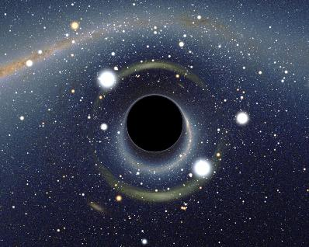
Property of Dependency-Preservation
If a decomposition is not dependency-preserving, therefore, that dependency is lost in the decomposition.
FD₄
FD₃
FD₁
FD₂

Slide 10
Example of Dependency Preservation
R(A B C D)
FD₁: A ➔ B
FD₂: B ➔ C
FD₃: C ➔ D
Decomposition: R₁(A B C) R₂(C D)

Slide 11
FD₁: A ➔ B
FD₂: B ➔ C
FD₃: C ➔ D
R₁( A B C )
FD₁
FD₂

Slide 12
FD₁: A ➔ B
FD₂: B ➔ C
FD₃: C ➔ D
R₂( C D )
FD₃

Slide 13
FD₁: A ➔ B
FD₂: B ➔ C
FD₃: C ➔ D
R₁( A B C ) R₂( C D )
FD₁
FD₃
FD₂
Has all 3 functional dependencies!
Therefore, it’s preserving the dependencies

Slide 14
Example of Non-Dependency Preservation
R(A B C D)
FD₁: A ➔ B
FD₂: B ➔ C
FD₃: C ➔ D
Decomposition: R₁(A C D) R₂(B C)

Slide 15
FD₁: A ➔ B
FD₂: B ➔ C
FD₃: C ➔ D
R₁( A C D )
FD₃

Slide 16
FD₁: A ➔ B
FD₂: B ➔ C
FD₃: C ➔ D
R₂( B C )
FD₂

Slide 17
FD₁: A ➔ B
FD₂: B ➔ C
FD₃: C ➔ D
R₁( A C D ) R₂( B C )
FD₃
FD₂
Does not support FD₁: A => B
Therefore, it does not preserve the dependencies

Slide 18
More Example
R(A B C D E)
FD₁: A ➔ B
FD₂: BC ➔ D
Decomposition: R₁(A C E) R₂(B C D) R₃(A B)

Slide 19
FD₁: A ➔ B
FD₂: BC ➔ D
R₁( A C E )
No Dependencies

Slide 20
FD₁: A ➔ B
FD₂: BC ➔ D
R₂( B C D )
FD₂

Slide 21
FD₁: A ➔ B
FD₂: BC ➔ D
R₃( A B )
FD₁

Slide 22
FD₁: A ➔ B
FD₂: BC ➔ D
R₁( A C E ) R₂( B C D )
FD₂
R₃( A B )
FD₁
Has all 2 functional dependencies!
Therefore, it’s preserving the dependencies

Slide 23

Exercise Problem

Slide 24
R(A, B, C, D, E, F )
FD₁: D ➔ A, B
FD₂: C ➔ E, F
Decomposition: R₁( A, C, D ) R₂( A, D, B ) R₃( D, E, F ) R₄( C, E, F )

Slide 25
R₁( A C D ) R₂( A D B ) R₃( D E F ) R₄( C E F )
FD1: D ➔ A, B
FD2: C ➔ E, F
FD₁
FD₂

Slide 26
Answer
Yes! This is a dependency-preservation

Slide 27
Properties of Relational Decompositions (5)
Lossless (Non-additive) Join Property of a Decomposition:
Definition:
Lossless join property: a decomposition D = {R₁, R₂, ..., R_{m}} of R has the lossless (nonadditive) join property with respect to the set of dependencies F on R if, for every relation state r of R that satisfies F, the following holds, where * is the natural join of all the relations in D:
* (π_{R1}(r), ..., π_{Rm}(r)) = r
Note: The word loss in lossless refers to loss of information, not to loss of tuples. In fact, for “loss of information” a better term is “addition of spurious information”

Slide 28
Example : Problem with Decomposition
R
Model Name | Price | Category
a11 | 100 | Canon
s20 | 200 | Nikon
a70 | 150 | Canon
R1
R2
Model Name | Category
a11 | Canon
s20 | Nikon
a70 | Canon
Price | Category
100 | Canon
200 | Nikon
150 | Canon

Slide 29
Example : Problem with Decomposition
R1 * R2
Model Name | Price | Category
a11 | 100 | Canon
a11 | 150 | Canon
s20 | 200 | Nikon
a70 | 100 | Canon
a70 | 150 | Canon
R
Model Name | Price | Category
a11 | 100 | Canon
s20 | 200 | Nikon
a70 | 150 | Canon

Slide 30
Properties of Relational Decompositions (6)
Lossless (Non-additive) Join Property of a Decomposition (cont.):
Algorithm 11.1: Testing for Lossless Join Property
Input: A universal relation R, a decomposition D = {R₁, R₂, ..., R_{m}} of R, and a set F of functional dependencies.
Create an initial matrix S with one row i for each relation R_{i} in D, and one column j for each attribute A_{j} in R.
Set S(i,j):=b_{ij} for all matrix entries. (* each b_{ij} is a distinct symbol associated with indices (i,j) *).
For each row i representing relation schema R_{i}
{for each column j representing attribute A_{j}
{if (relation R_{i} includes attribute A_{j}) then set S(i,j):= a_{j};};};
(* each a_{j} is a distinct symbol associated with index (j) *)

Slide 31
Properties of Relational Decompositions (7)
Lossless (Non-additive) Join Property of a Decomposition (cont.):
Algorithm 11.1: Testing for Lossless Join Property (cont.)
Repeat the following loop until a complete loop execution results in no changes to S
{for each functional dependency X Y in F
{for all rows in S which have the same symbols in the columns corresponding to attributes in X
{make the symbols in each column that correspond to an attribute in Y be the same in all these rows as follows: if any of the rows has an “a” symbol for the column, set the other rows to that same “a” symbol in the column. If no “a” symbol exists for the attribute in any of the rows, choose one of the “b” symbols that appear in one of the rows for the attribute and set the other rows to that same “b” symbol in the column ;};};};
If a row is made up entirely of “a” symbols, then the decomposition has the lossless join property; otherwise it does not.

Slide 32
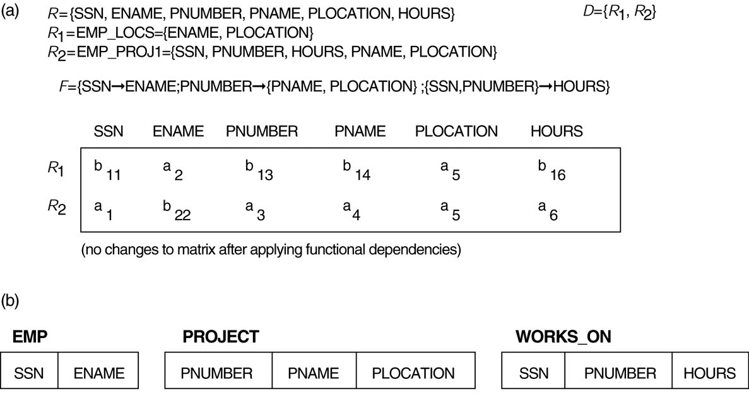
Properties of Relational Decompositions (8) Lossless (nonadditive) join test for n-ary decompositions. (a) Case 1: Decomposition of EMP_PROJ into EMP_PROJ1 and EMP_LOCS fails test. (b) A decomposition of EMP_PROJ that has the lossless join property.

Slide 33
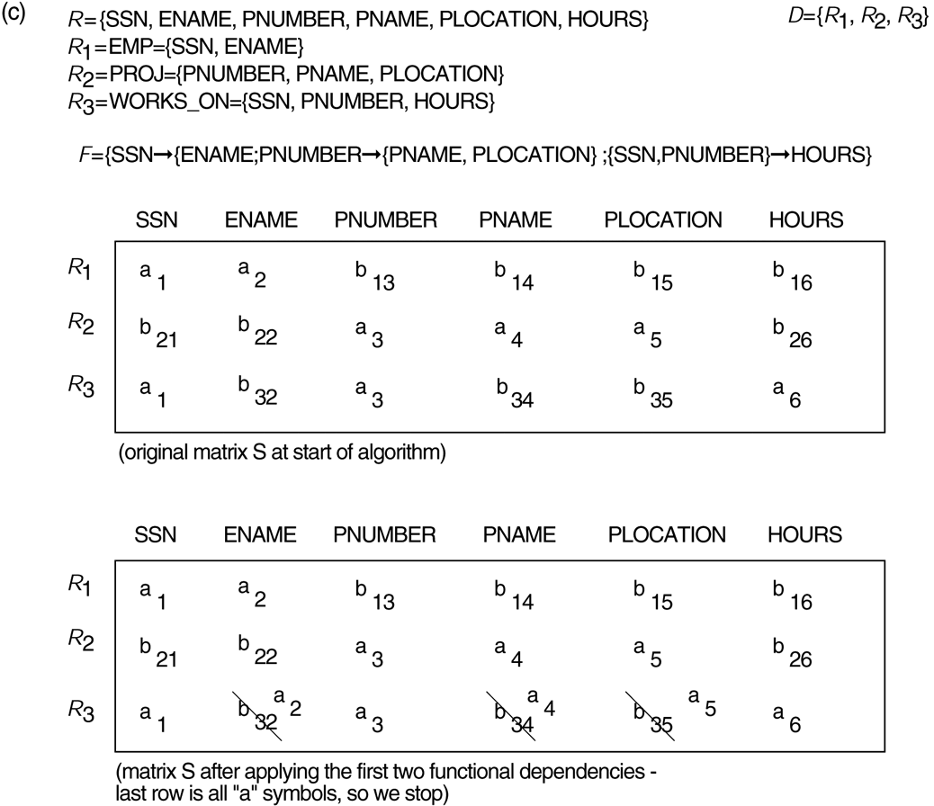
Properties of Relational Decompositions (8)
Lossless (nonadditive) join test for n-ary decompositions. (c) Case 2: Decomposition of EMP_PROJ into EMP, PROJECT, and WORKS_ON satisfies test.

Slide 34
Properties of Relational Decompositions (9)
Testing Binary Decompositions for Lossless Join Property:
Binary Decomposition: decomposition of a relation R into two relations.
PROPERTY LJ1 (lossless join test for binary decompositions): A decomposition D = {R₁, R₂} of R has the lossless join property with respect to a set of functional dependencies F on R if and only if either
The f.d. ((R₁ ∩ R₂)  (R₁- R₂)) is in F⁺, or
The f.d. ((R₁ ∩ R₂)  (R₂ - R₁)) is in F⁺.

Slide 35
2. Algorithms for Relational Database Schema Design (1)
Algorithm 11.2: Relational Synthesis into 3NF with Dependency Preservation (Relational Synthesis Algorithm)
Input: A universal relation R and a set of functional dependencies F on the attributes of R.
Find a minimal cover G for F (use Algorithm 10.2);
For each left-hand-side X of a functional dependency that appears in G, create a relation schema in D with attributes {X υ {A₁} υ {A₂} ... υ {A_{k}}}, where X  A₁, X  A₂, ..., X  A_{k} are the only dependencies in G with X as left-hand-side (X is the key of this relation) ;
Place any remaining attributes (that have not been placed in any relation) in a single relation schema to ensure the attribute preservation property.
Claim 3: Every relation schema created by Algorithm 11.2 is in 3NF.

Slide 36
Algorithms for Relational Database Schema Design (2)
Algorithm 11.3: Relational Decomposition into BCNF with Lossless (non-additive) join property
Input: A universal relation R and a set of functional dependencies F on the attributes of R.
Set D := {R};
While there is a relation schema Q in D that is not in BCNF
do {
choose a relation schema Q in D that is not in BCNF;
find a functional dependency X  Y in Q that violates BCNF;
replace Q in D by two relation schemas (Q - Y) and (X υ Y);
};
Assumption: No null values are allowed for the join attributes.

Slide 37
Algorithms for Relational Database Schema Design (3)
Algorithm 11.4 Relational Synthesis into 3NF with Dependency Preservation and Lossless (Non-Additive) Join Property
Input: A universal relation R and a set of functional dependencies F on the attributes of R.
Find a minimal cover G for F (Use Algorithm 10.2).
For each left-hand-side X of a functional dependency that appears in G, create a relation schema in D with attributes {X υ {A₁} υ {A₂} ... υ {A_{k}}}, where X  A₁, X  A₂, ..., X –>A_{k} are the only dependencies in G with X as left-hand-side (X is the key of this relation).
If none of the relation schemas in D contains a key of R, then create one more relation schema in D that contains attributes that form a key of R. (Use Algorithm 11.4a to find the key of R)
Eliminate redundant relations from the resulting set of relations in the relational database schema. A relation R is considered redundant if R is a projection of another relation S in the schema; alternately, R is subsumed by S.

Slide 38
Algorithms for Relational Database Schema Design (4)
Algorithm 11.4a Finding a Key K for R Given a set F of Functional Dependencies
Input: A universal relation R and a set of functional dependencies F on the attributes of R.
Set K := R.
For each attribute A in K {
compute (K - A)⁺ with respect to F;
If (K - A)⁺ contains all the attributes in R,
then set K := K - {A}; }

Slide 39
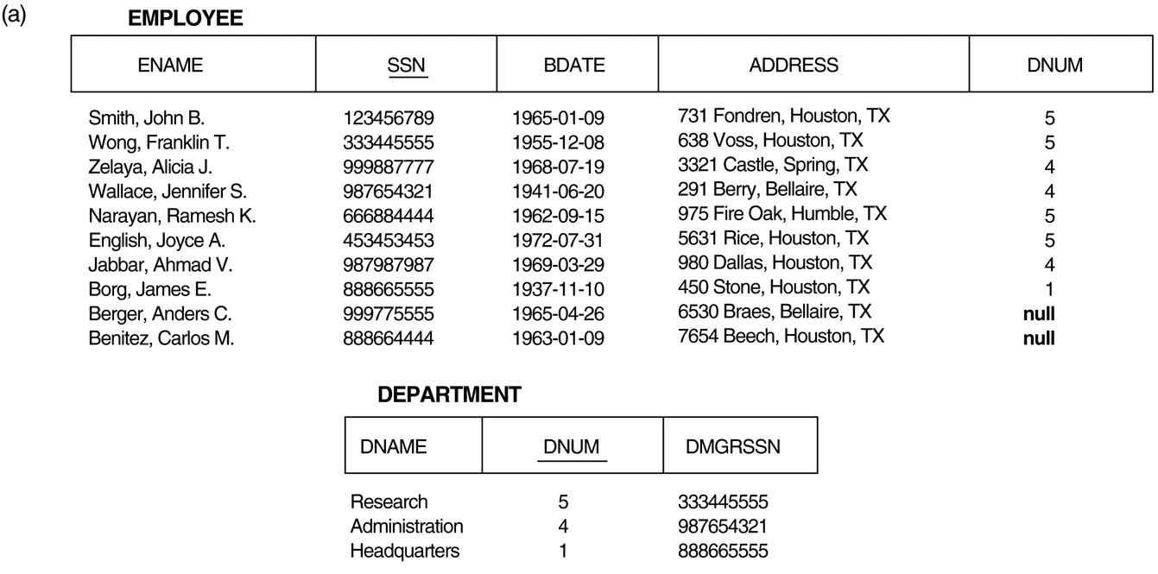
Algorithms for Relational Database Schema Design (5) Issues with null-value joins. (a) Some EMPLOYEE tuples have null for the join attribute DNUM.

Slide 40
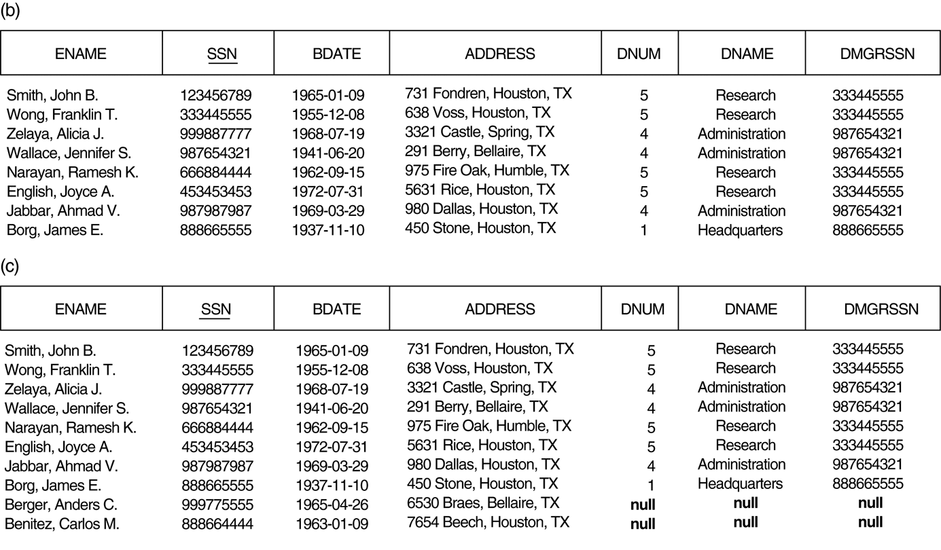
Algorithms for Relational Database Schema Design (5) Issues with null-value joins. (b) Result of applying NATURAL JOIN to the EMPLOYEE and DEPARTMENT relations. (c) Result of applying LEFT OUTER JOIN to EMPLOYEE and DEPARTMENT.

Slide 41
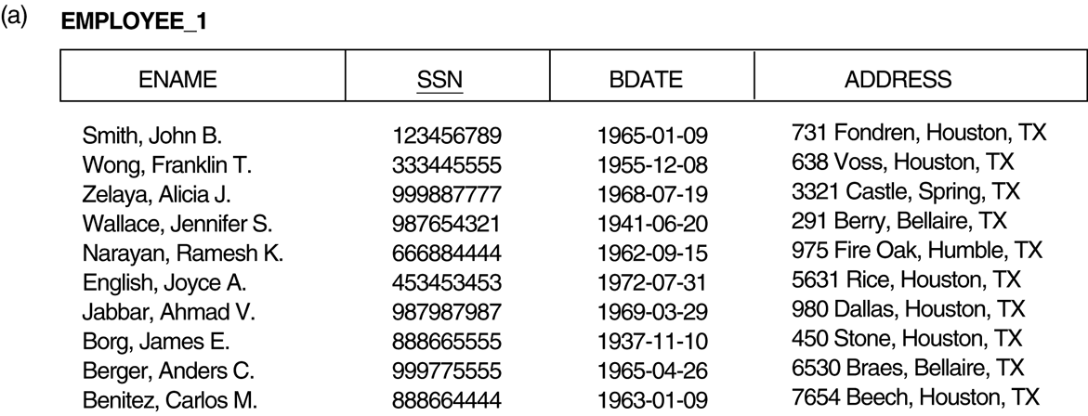
Algorithms for Relational Database Schema Design (6) The “dangling tuple” problem. (a) The relation EMPLOYEE_1 (includes all attributes of EMPLOYEE from frigure 11.2a except DNUM).

Slide 42
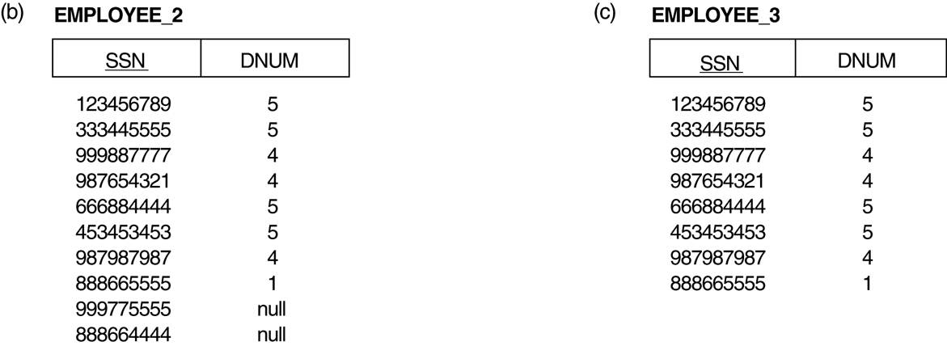
Algorithms for Relational Database Schema Design (6) The “dangling tuple” problem. (b) The relation EMPLOYEE_2 (includes DNUM attribute with null values). (c) The relation EMPLOYEE_3 (includes DNUM attribute but does not include tuples for which DNUM has null values).

Slide 43
Algorithms for Relational Database Schema Design (7)
Discussion of Normalization Algorithms:
Problems:
The database designer must first specify all the relevant functional dependencies among the database attributes.
These algorithms are not deterministic in general.
It is not always possible to find a decomposition into relation schemas that preserves dependencies and allows each relation schema in the decomposition to be in BCNF (instead of 3NF as in Algorithm 11.4).

Slide 44
Algorithms for Relational Database Schema Design (8)
Algorithm
Input
Output
Properties/Purpose
Remarks
11.1
A decomposition D of R and a set F of functional dependencies
Boolean result: yes or no for lossless join property
Testing for non-additive join decomposition
See a simpler test in Section 11.1.4 for binary decompositions
11.2
Set of functional dependencies F
A set of relations in 3NF
Dependency preservation
No guarantee of satisfying lossless join property
11.3
Set of functional dependencies F
A set of relations in BCNF
Lossless join decomposition
No guarantee of dependency preservation
11.4
Set of functional dependencies F
A set of relations in 3NF
Lossless join and dependency preserving decomposition
May not achieve BCNF
11.4a
Relation schema R with a set of functional dependencies F
Key K of R
To find a key K
(which is a subset of R)
The entire relation R is always a default superkey

Slide 45
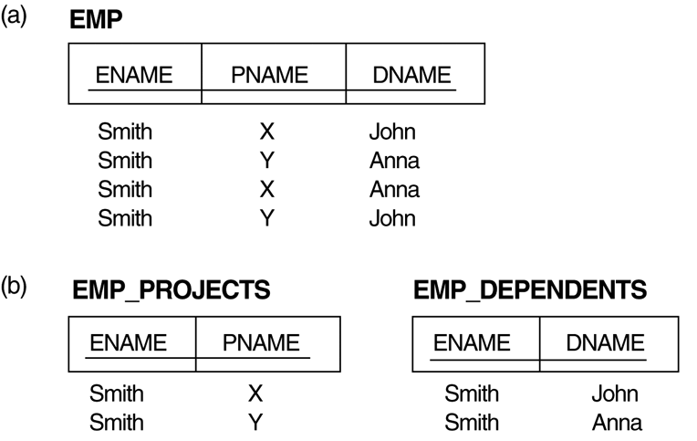
3. Multivalued Dependencies and Fourth Normal Form (1) (a) The EMP relation with two MVDs: ENAME —>> PNAME and ENAME —>> DNAME. (b) Decomposing the EMP relation into two 4NF relations EMP_PROJECTS and EMP_DEPENDENTS.

Slide 46
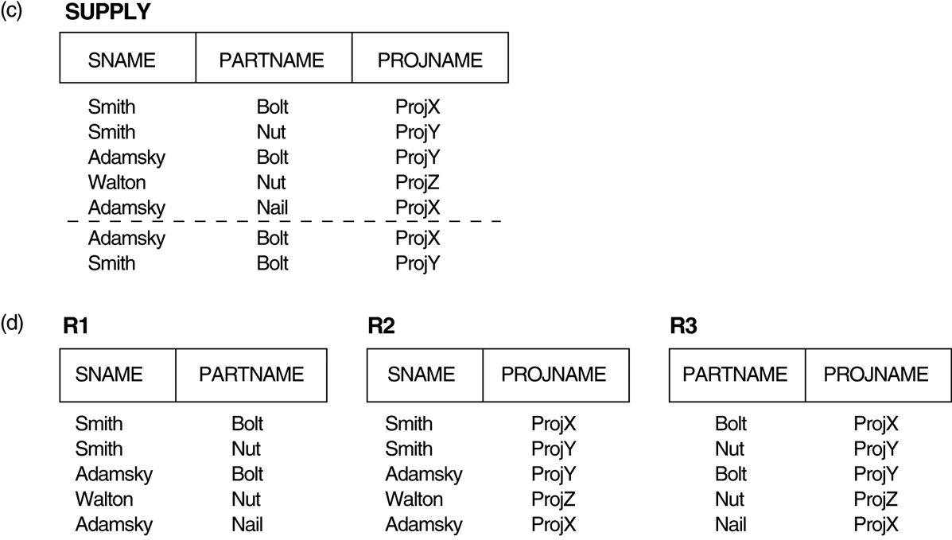
3. Multivalued Dependencies and Fourth Normal Form (1) (c) The relation SUPPLY with no MVDs is in 4NF but not in 5NF if it has the JD(R1, R2, R3). (d) Decomposing the relation SUPPLY into the 5NF relations R1, R2, and R3.

Slide 47
Multivalued Dependencies and Fourth Normal Form (2)
Definition:
A multivalued dependency (MVD) X —>> Y specified on relation schema R, where X and Y are both subsets of R, specifies the following constraint on any relation state r of R: If two tuples t₁ and t₂ exist in r such that t₁[X] = t₂[X], then two tuples t₃ and t₄ should also exist in r with the following properties, where we use Z to denote (R 2 (X υ Y)):
· t₃[X] = t₄[X] = t₁[X] = t₂[X].
· t₃[Y] = t₁[Y] and t₄[Y] = t₂[Y].
· t₃[Z] = t₂[Z] and t₄[Z] = t₁[Z].
An MVD X —>> Y in R is called a trivial MVD if (a) Y is a subset of X, or (b) X υ Y = R.

Slide 48
Multivalued Dependencies and Fourth Normal Form (4)
Definition:
A relation schema R is in 4NF with respect to a set of dependencies F (that includes functional dependencies and multivalued dependencies) if, for every nontrivial multivalued dependency X —>> Y in F⁺, X is a superkey for R.
Note: F⁺ is the (complete) set of all dependencies (functional or multivalued) that will hold in every relation state r of R that satisfies F. It is also called the closure of F.

Slide 49
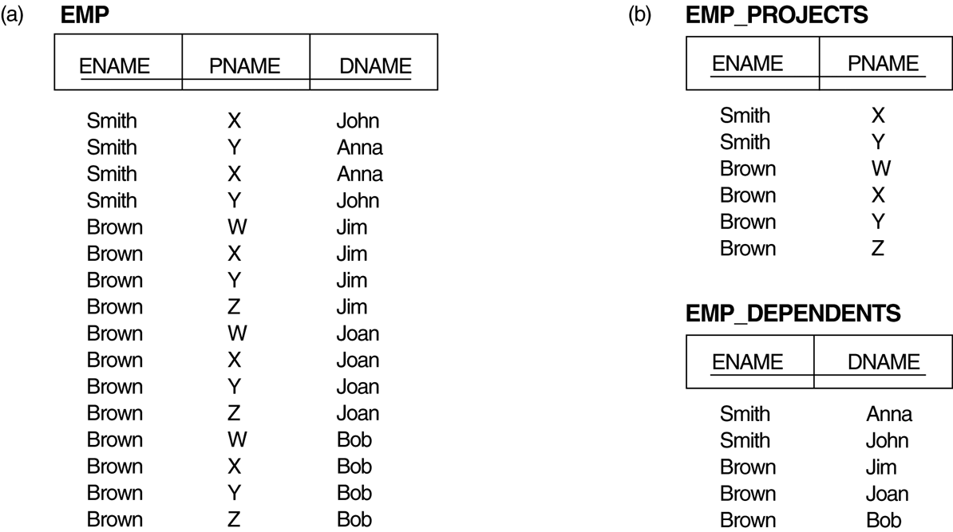
Multivalued Dependencies and Fourth Normal Form (5) Decomposing a relation state of EMP that is not in 4NF. (a) EMP relation with additional tuples. (b) Two corresponding 4NF relations EMP_PROJECTS and EMP_DEPENDENTS.

Slide 50
THANK YOU

